Slide 1

Introduction to Rest APIs using Python and Flask
DataEthics4All presents
by
Harshit Saraswat
(Mentor @ Ethics4NGAI Hackathon)

Slide 2

About Me
Full Stack AI Developer at a startup based in India
Computer Science Engineering Graduate
Worked in technologies such as ML/DL/Computer Vision/NLP, Android App Development, Web Development
Participated in numerous hackathons till now
Mentored in a few hackathons

Slide 3
Why DataEthics4All?
In the recent years, the world of AI and Data has been improving rapidly.
With technological advancement, we often tend to lose sight on the thin line of ethics wrt this field.
In smaller developing countries with no strict data privacy laws, people aren’t aware of their data rights and how AI and data can harm them more than it’ll do good to them.
DataEthics4All is an initiative to bring people from all around the world together to make them aware of the Data Ethics
Strong and Diverse Community
The main goal isn’t about creating the AI we need but the AI we deserve

Slide 4
Agenda
Why this bootcamp?
App Examples
What is an API? Why do we need an API?
What is a RestAPI? How is it different from other APIs?
Different Types of RestAPIs:- GET,POST,PUT,DELETE
Flask. Why Flask in Python? Flask vs Django.
Introduction to Postman and how to use it to test your APIs?
Simple Flask App Initiation (Code Along)
Simple GET Request with Flask (Code Along)
Simple POST Request with Flask (Code Along)
Working with Request Headers in Flask (Code Along)
Working with Request Body(Form Data/ JSON) in Flask (Code Along)
Working with Request Parameters/ URL Parameters in Flask (Code Along)
Working with Files in Requests with Flask (Code Along)
Working With AI Models in APIs
Using SSL/HTTPS for development/testing in Flask
Interacting with Flask APIs in different devices (Quick Introduction on how to rapidly call APIs in Android Apps, Websites)
Courses To Follow for In Depth Flask Tutorials (YouTube Channels and Playlists)
QnA

Slide 5
Why this boot camp?
People value products more than just backend
Full Stack offers value
Helps your solutions to be accessible to the outside world
Hard to deploy large models on small devices
Reduces Dependency on Client Side Systems
Maintain Universal Code at one place
Prevent Reverse Engineering
Not just a skill for this hack but for the future too

Slide 6

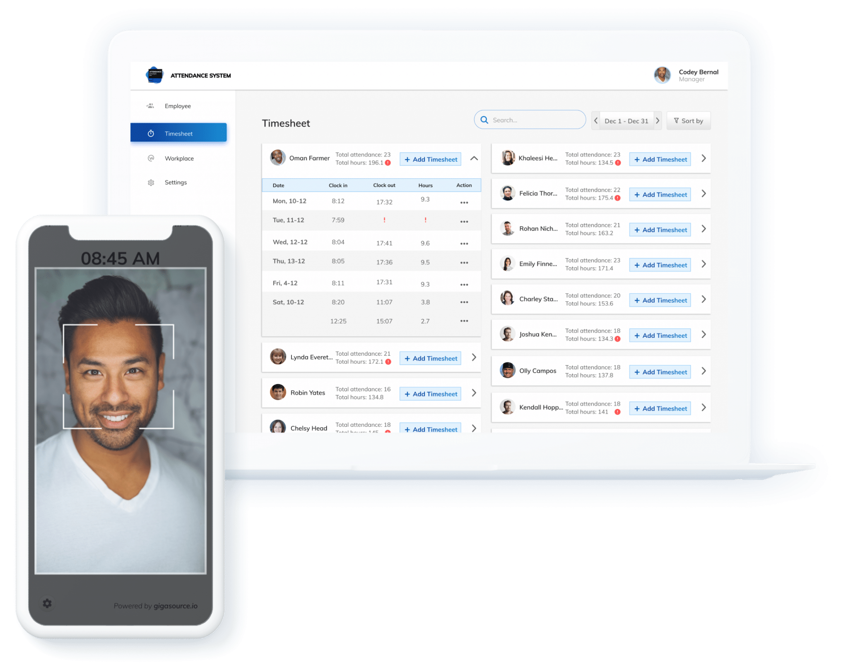
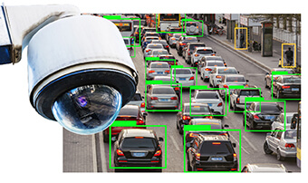




App Examples

Slide 7
What is an API? Why do we need it?
API:
Technically, API stands for Application Programming Interface, which is a software intermediary that allows two applications to talk to each other. Each time you use an app like Facebook, send an instant message, or check the weather on your phone, you’re using an API.
At some point or another, most large companies have built APIs for their customers, or for internal use.
APIs as a way to serve your customers
Prevent Theft or Reverse Engineering
Implement Data Sharing

Slide 8
What is a RestAPI? How is it different from other APIs?
REST stands for Representational state transfer. It’s an architecture.
Guiding Principles:
Client-Server
Stateless
Cacheable
Uniform Interface
Layered System
Code on demand (optional)
Why REST?
Client Server Separation
Platform Independent
Reliability, Scalability
Integrate most kind of data

Slide 9
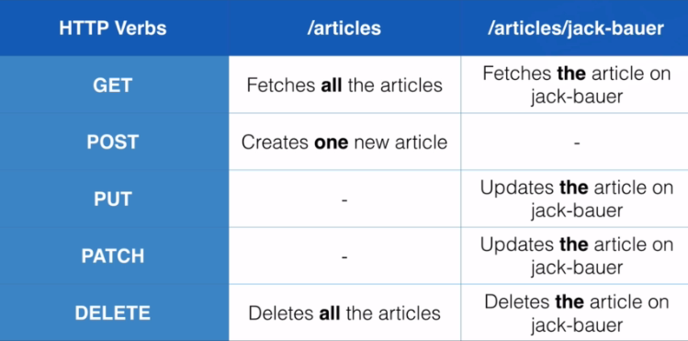
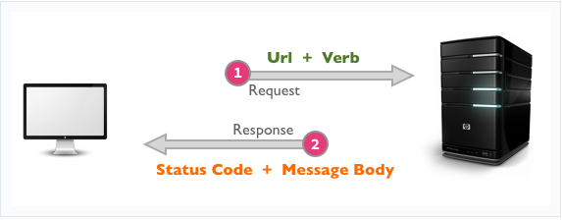
Different Types of Rest APIs:- GET, POST, PUT, DELETE, Patch
GET - Used to fetch the specified resource
POST - Used to create new data at the specified resource
PUT - Used replace existing data at the specified resource
DELETE - Used to delete existing data at the specified resource
PATCH - Used to update/modify existing data at the specified resource

Slide 10

Flask. Why Flask? Flask vs Django.
Simple API Development Framework for Python
Supports REST
Minimal Coding
Easy to Setup and Run
Debug Console

Slide 11


Slide 12
Let’s Code

Slide 13
HTTPS and SSL in Flask APIs
Install OpenSSL
Run the following command
req -x509 -newkey rsa:4096 -nodes -out cert.pem -keyout key.pem -days 365

Slide 14
Interacting with Flask APIs in Android Apps and Websites/Web Apps
Android:
Retrofit
OKHttp
FastAndroidNetworking (Recommended for First Timers)
https://github.com/amitshekhariitbhu/Fast-Android-Networking
Websites:
XMLHTTPRequest (XHR)
AJAX
FetchAPI (Recommended as new and easy)
https://developer.mozilla.org/en-US/docs/Web/API/Fetch_API/Using_Fetch

Slide 15



Recommendations for More Content
Pretty Printed
Youtube Link: https://www.youtube.com/c/PrettyPrintedTutorials
Corey Schafer
Youtube Link: https://www.youtube.com/c/Coreyms

Slide 16
Thanks

